Slide 1
Sub Saharan Africa
public
An Introduction to DHL Express operation in SSA Region
DHL Express

Slide 2
The number 1 Express and logistics company in the world
Corporate Center
Mail
EXPRESS
GLOBAL FORWARDING, FREIGHT
SUPPLY CHAIN
DHL Customer Solutions & Innovation
GLOBAL BUSINESS SERVICES
Notes:
2
2
2

Slide 3
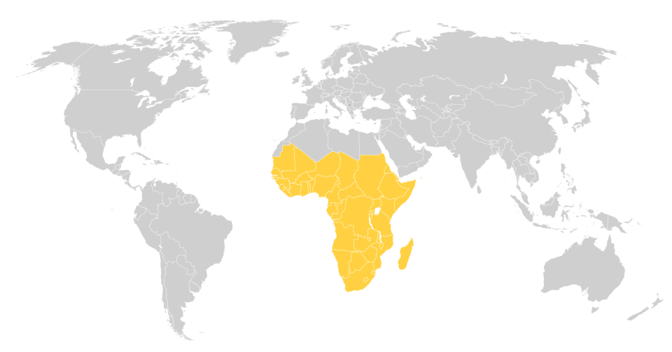
The industry leader
0
Europe
Americas
10%
5%
15%
15%
40%
25%
Asia Pacific
25%
10%
EEMEA
60%
30%
35%
25%
45%
5%
10%
20%
10%
10%
DHL
10%
FedEx
UPS
TNT
Others
*2009 | TDI market value per region

Slide 4
Experience, unparalleled infrastructure and great people
37
Years in Africa as Leader & Pioneer
51
Countries & Territories
3,800
Retail Service Points
15
1,250
Vehicles
Dedicated Aircraft
400
Commercial Flights
1978
3,500
16,000
First Office in South Africa
Certified International Specialists
Active Customers and
Thousands of Cash Customers

Slide 5
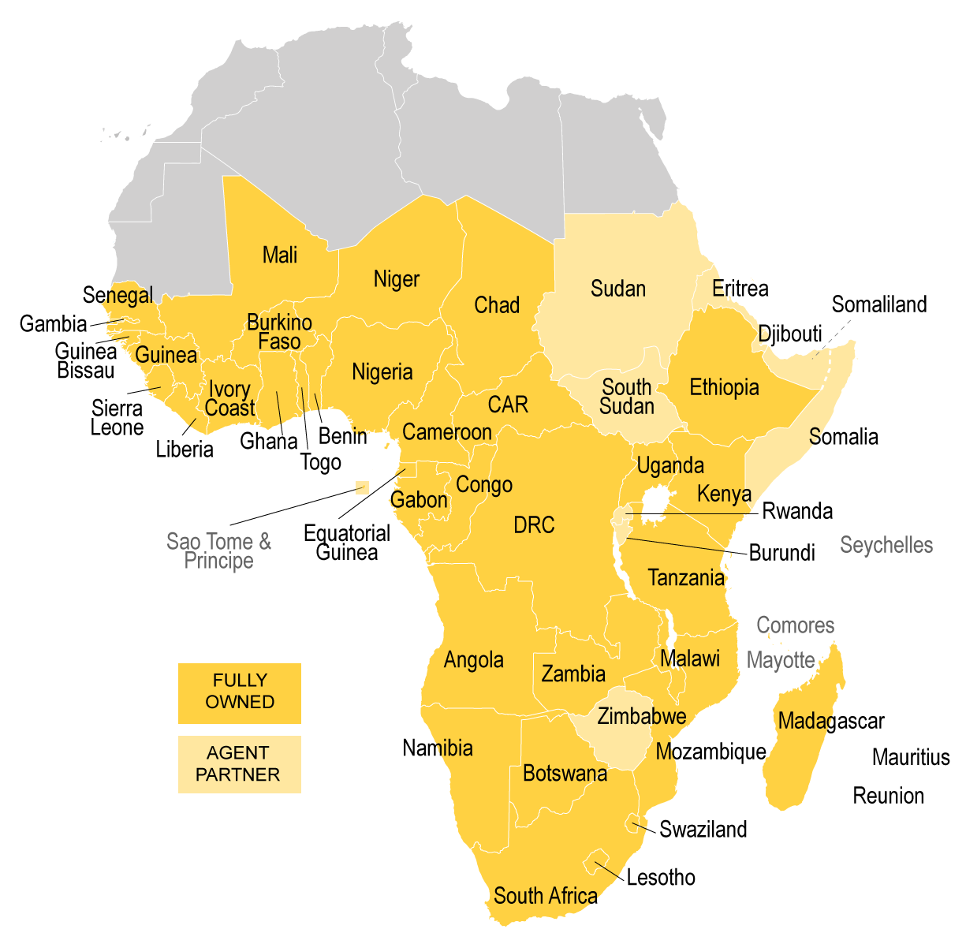
Undisputed leader in Africa
40 fully owned subsidiaries
11 agencies
Notes:
5

Slide 6
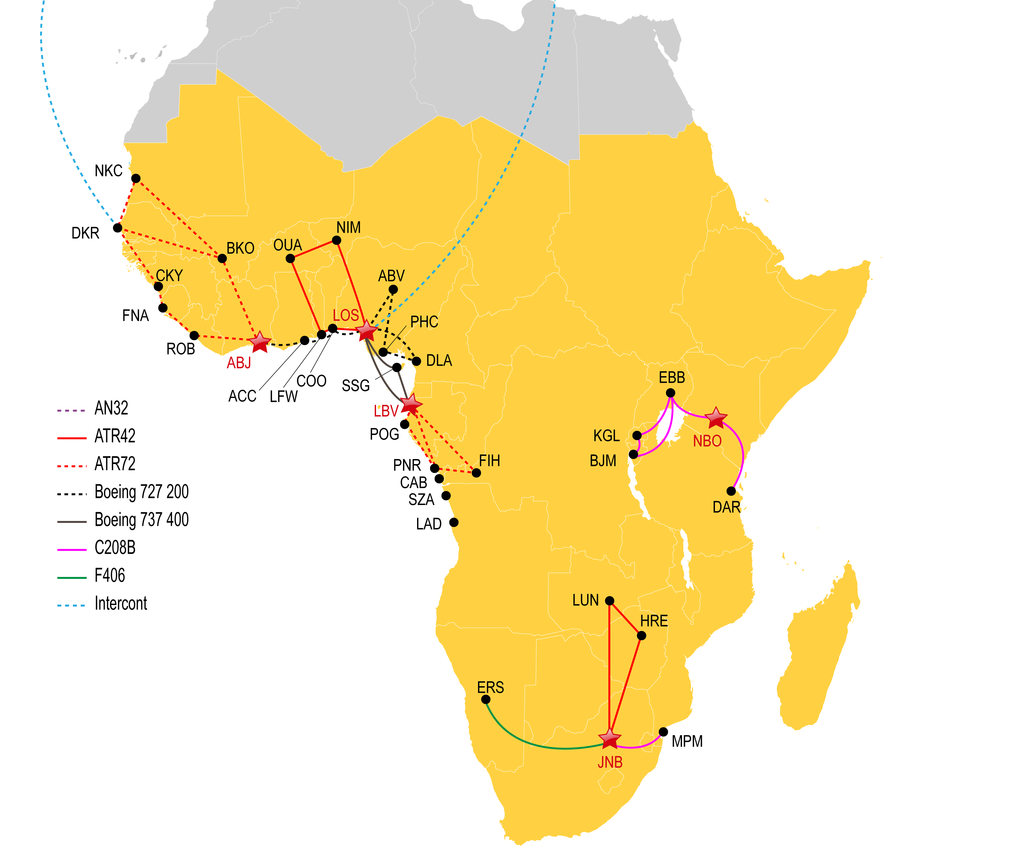
Unparalleled infrastructure and best in class operations
>95%
Transit Performance
>90%
Pre noon city delivery
QCC
Quality Control Center
19
TAPA certified facilities with more on the way
> 70%
Cleared on arrival
12.5
Million shipments
5 hubs at
the core of
our operations
56
Million Tones
> 80%
Pick Up within 60 minutes of booking

Slide 7
Connecting Africa with the World and the World with Africa
ANC
ANC
EMA
LEJ
BRU
CDG
FRA
ICN
JFK
ICN
LAX
PVG
LAX
CVG
GSO
DEL
CVG
MIA
BAH
PVG
HKG
MEX
SJU
DXB
HKG
SJO
CCS
DKR
BKK
PTY
BOG
LOS
SIN
GYE
PER
SYD
AKL
Lines on map do not include weekend, commercial, one-off or special routings.

Slide 8
Sub-Saharan Africa hub catchment areas
ZA
Johannesburg
Africa & the World connected with five hubs
KE
Nairobi
NG
Lagos
CI
Abidjan
GA
Libreville
Routing depends on various factors: Customer requirements, market leading transit time, competitor offering, shipment volume from point A to B
Hubs act as points of consolidation and bring down unit cost
5 hubs at
the core of
our operations

Slide 9
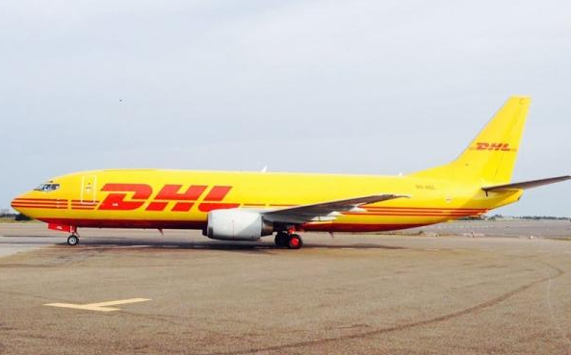
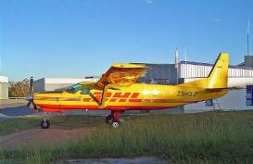
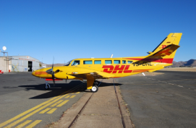
Only carrier to have a dedicated air network in Africa
Boeing 737-400
No. in Fleet: 1
Capacity: 20.8 Metric Tons
Max. Range 2,500 km’s
DHL Hubs: LBV
Door Size: 216 x 348 cm’s
Cargo Hold: 38.5 CBM
Cessna C208B Grand Caravan
No. in Fleet 3
Capacity: 1.1 Metric Tons
Max. Range: 2,000 km’s
DHL Hubs: NBO & JNB
Door Size: 1.27 x 1.24 cm’s
Cargo Hold: 12 CBM
RIEMS F406 Caravan II
No. in Fleet: 1
Capacity: 1 Metric Ton
Max. Range: 2,135 km’s
DHL Hubs: JNB
Door Size: 124 x 116 cm’s
Cargo Hold: 6.5 CBM

Slide 10
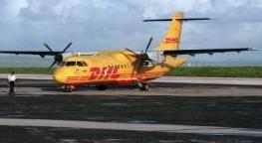
Only carrier to have a dedicated air network in Africa
ATR 72F
No. in Fleet: 2 (1 x LCD palletized, 1 x normal config)
Capacity: 7.8 Metric tons
Max. Range: 1,650 km’s
DHL Hubs: DKR, LBV
Door Size: 204 x 303 cm’s
Cargo Hold: 75 CBM
ATR 42-320
No. in Fleet: 3
Capacity: 4.5 Metric Tons
Max. Range 1,554 km’s
DHL Hubs: LFW, ABJ, JNB
Door Size: 216 x 348 cm’s
Cargo Hold: 38.5 CBM
10

Slide 11
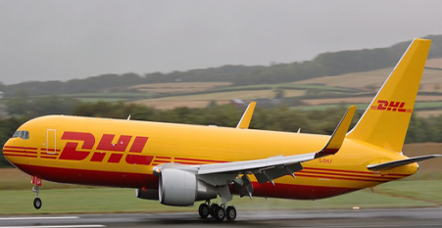
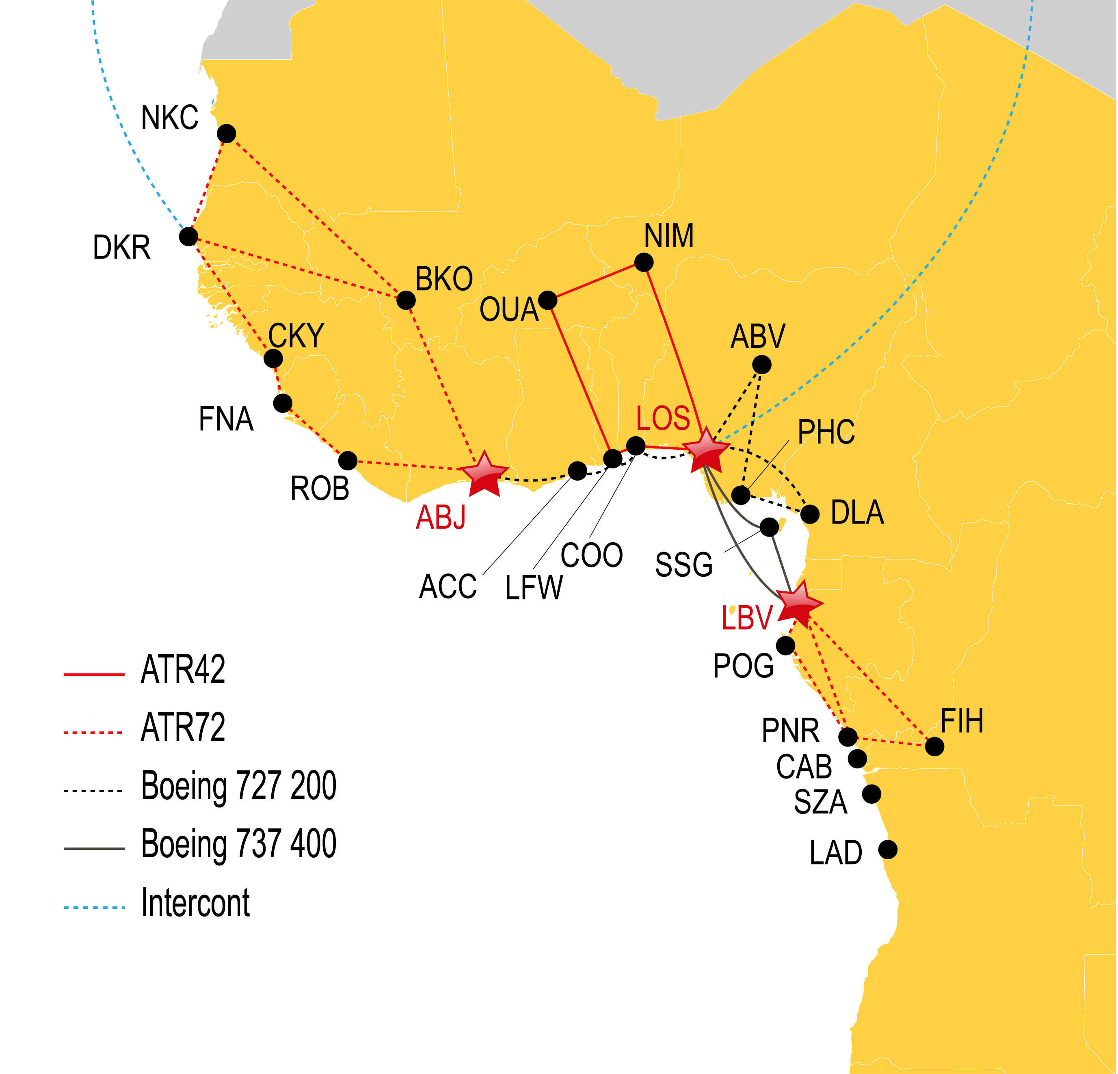
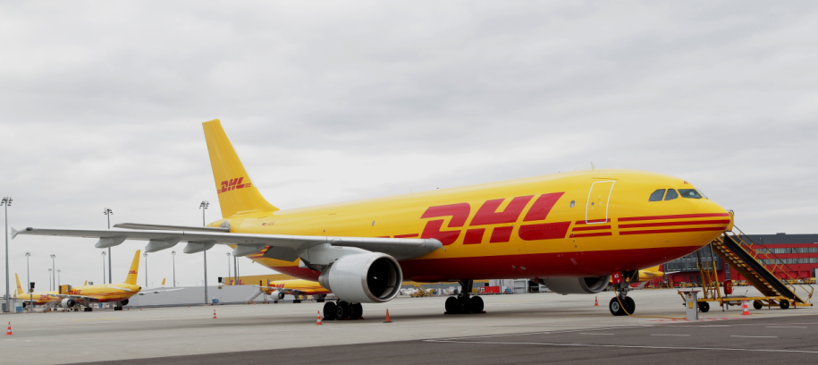
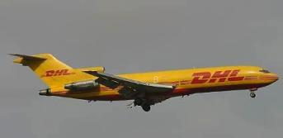
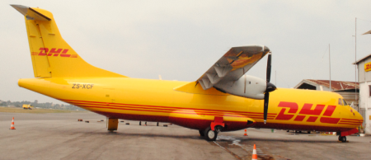
West Africa – dedicated air network
Boeing 767 Freighter
1 x A300
1 x B737
2 x Boeing 727F
2 x ATR 42 & 2 ATR72
DHL Express TDI MENA Network Review

Slide 12
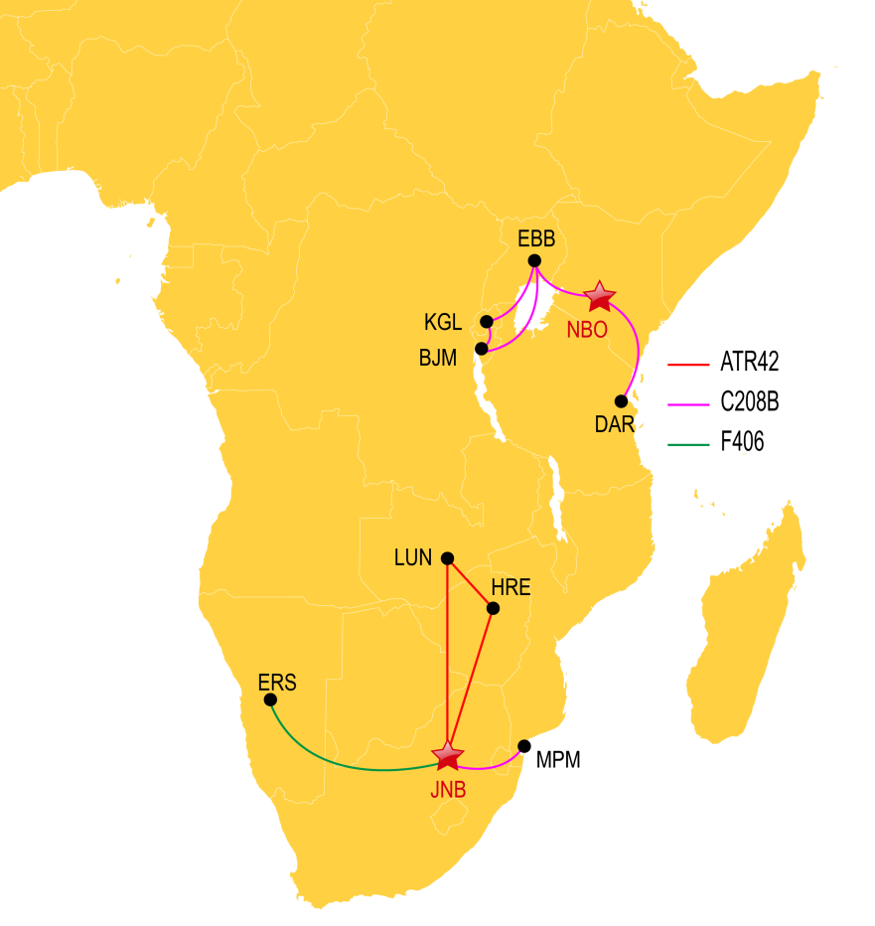
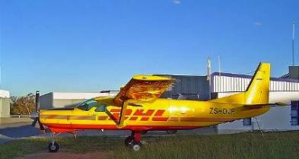
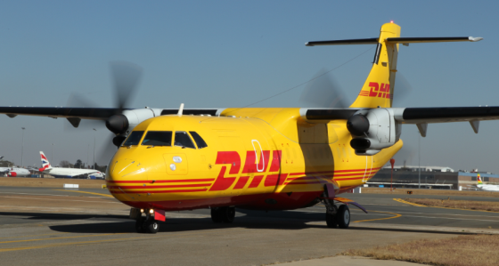
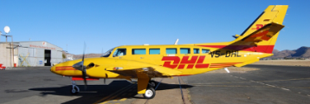
East, South and Central Africa – dedicated air networks
3 x Cessna C208B
1 x ATR 42
1 x ATR 42
1 x F406

Slide 13
Security doesn’t happen by chance – 19 TAPA certified facilities and state of the art security in all
LOS HUB
LOS GTW
LOS ELC
BKO GTW
DKR GTW
CAPE VERDE
MALI
NIGER
ERITREA
ADD CO & GOPS
GAMBIA
SENEGAL
BURKINA
FASO
CHAD
SUDAN
GUINEA BISSAU
GUINEA REP
BENIN
DJIBOUTI
EBB CO & GOPS
SIERRA LEONE
COTE
D’IVOIRE
TOGO
NIGERIA
ETHIOPIA
SOMALILAND
LIBERIA
CENTRAL AFRICAN REP
ABJ GTW
GHANA
CAMEROON
SOMALIA
NBO GTW
KE C0 & GOPS
ACC GTW
EQUATORIAL GUINEA
UGANDA
KENYA
SAO TOME
GABON
RWANDA
DAR GTW
DLA GTW
CONGO
BURUNDI
LBV GTW
DRC
TANZANIA
FIH GTW
SEYCHELLES
ANGOLA
COMOROS
LAD CO & GOPS
ZAMBIA
MALAWI
MAYOTTE
MRU GTW
GBE CO & GOPS
MOZAMBIQUE
MADAGASCAR
NAMIBIA
ZIMBABWE
MAURITIUS
WDH GTW
BOTSWANA
REUNION
RUN CO & GTW
Current 19 Facilities in 11 Countries
JNB HUB
CPT GTW
PRY SVC
SDN SVC
ISN SVC
MDR SVC
DUR SVC
SWAZILAND
TNR GTW
2014 Plan 11 Facilities in 10 Countries
LESOTHO
LUN GTW
End 2014 30 Facilities in 21 Countries
SOUTH AFRICA
MPM GTW
MPM CO & GOPS

Slide 14
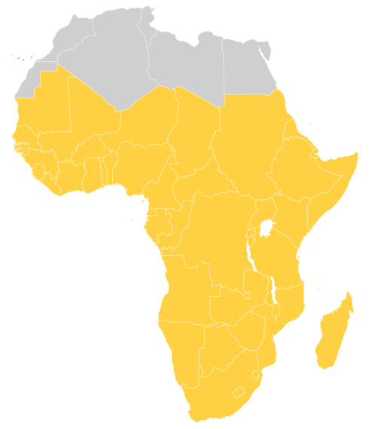
Customs clearance experts in Africa
Expertise and local know-how to facilitate trade
We help you cut through the clutter of procedures
Our teams keep up to date with the constantly changing regulations
We assist you with compliance to all customs requirements

Slide 15
No one knows Africa like we do
Angola is the only country with an official deminimus value of USD 370 whereas
In Sub-Saharan Africa, exchange rates for customs clearance change every day whereas in Asia, exchange rates change weekly to facilitate trade; mitigate rework for insignificant monetary impact, improved productivity and expedited clearance
In Tanzania deminimus value is USD 3 instead
Gabon high value clearance >USD 100 takes an average of 5 days to clear because of prevailing
Import controls whereas
In Nigeria high value clearance take’s up to 4 hours because of liberalized customs procedures
In Botswana, Customs at border crossings turn away trucks because systems are down whereas
In Zimbabwe, Customs are able to process manual clearances and avert congestion at border crossings

Slide 16
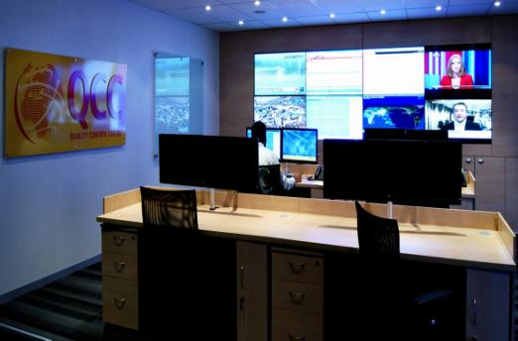
Quality Control Centre – state of the art technology
Using the industry benchmark is your advantage
Reliable & consistent transit time performance
Pro-active notification on service issues
End-to-end shipment visibility

Slide 17
Recent key achievements
TAPA certified in 19 facilities + Tanzania new warehouse & airport facility live at TAPA ‘A’ standard
Senegal
New airside facility with new BRU-DKR 757 once a week flight
Sub-Saharan Africa – Improved customs clearance systems and management
95% on time deliveries
New sign on glass proof of delivery deployed to six SSA countries
Mauritius
Express Logistics Centre clearance platform + TAPA Accreditation
West Africa
B727 upgraded to branded B737
Nigeria
B767 direct Brussels/Lagos
+ new Abuja flight + more space landside airside
Burkino Faso
New country office and service centre in Ouagadougou
South Africa
New Cape Town gateway with drive-in service centre. New Durban drive-in service centre
Network
Upgrade JNB HRE to ATR42 (4T) aircraft + West Africa with 2 new ATR72 (7T) aircraft
Customer Service systems upgraded to have calls answered within 10 seconds
Mozambique
New operational facility in port city of Pemba now opened
Notes:
15/03/2019
Singapore HUB Visit
17
B727 upgraded to branded B737

Slide 18
Certified International Specialists
3,500 insanely customer centric Certified International Specialists
In DHL you will experience our Certified International Specialists with over 35 years of African knowledge, a cohesive team that is “Insanely customer centric”, acting locally and thinking globally, a company that is easy to do business with.
You focus on your business, your core competency and let us do the rest, providing you with the solution and absolute peace of mind.

